Slide 1
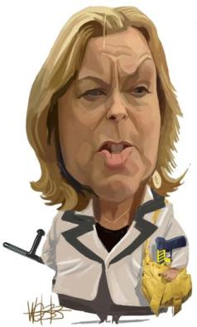
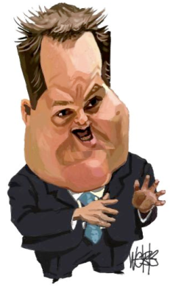
The Family Court Reforms:
Why?
What?
Where to?
How to make it work?
Auckland Family Courts Association
Professor Mark Henaghan
9 February 2016

Slide 2

Why?
The Rhetoric:
Modern, accessible, responsive to children and vulnerable people
Efficient, effective, sustainable
Less adversarial
Improve responses to victims of domestic violence

Slide 3

Why?
The Reality
Withdrawal of State support for family disputes
Privatisation of family law
Saving money ($30 million)
Delegalisation/Contractual

Slide 4
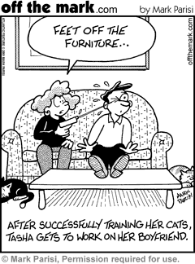
Behaviour Focus
Modifying expectations
Modifying behaviour
Accept or be reconciled to a state of affairs, whatever it may be
No external measures

Slide 5

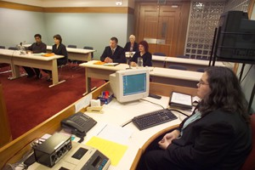
Outcome Focus
Is the outcome fair?
  Actual result reached fair?
  Method used fair
External measure
  Family Justice system

Slide 6

What Is It All About?
Its about a just settlement not just about settlement
-Dame Hazel Genn

Slide 7



What?
Mandatory FDR (with some exceptions)
Restrictions on legal representation
No mandatory lawyer for the child

Slide 8

What?
The Big Gaps
Who can attend FDR?
Number of sessions?
Children’s views in FDR?

Slide 9

Criticisms of Mediation
“One so called ‘myth’ is the accepted wisdom that mediators have only procedural power: it is the parties who reach a decision on what to do. The reality is that we steer the mediation every inch of the way in terms of content as well as process. We do this by being more (or less) directive, and more (or less) interventionist, depending on our personality and our prejudices”
-Linda Fisher

Slide 10
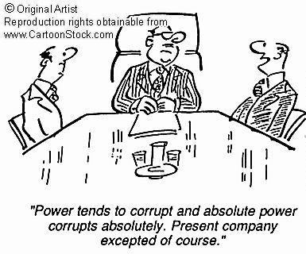
Criticisms of Mediation Cont.
The more mandatory we make mediation the more power we give mediators

Slide 11

Criticisms of Mediation Cont.
Neutrality impossible
Selective facilitation
Framing issues
Shepherding discussion
Impartiality & neutrality cannot be separated
No independent scrutiny
No normative framework

Slide 12
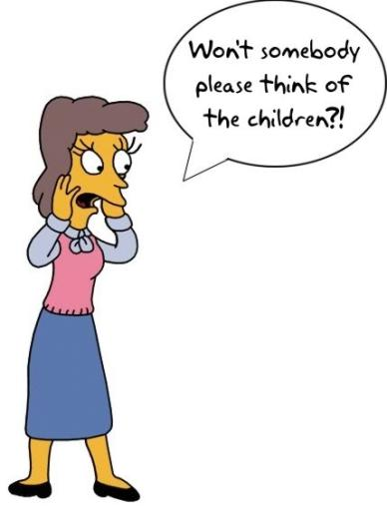
Criticisms of Mediation Cont.
Arrangements which best meet parents’ circumstances are not “focused on the best interests of the child”
-Eva Ryrstedt (2012)

Slide 13

UK Mediation Experience
Looking to the Future: Mediation and the Grounds for Divorce (1995)
  Compulsory information sessions – to encourage mediation
  Meeting motivated them to a see a lawyer
Dingwell (2010)
  “mediation increased costs because so many referrals failed and it simply became an extra step in the process”

Slide 14


Davies Study
Evaluation of Mediation Pilot (Involving 1055 consumers 1997-2001)
  60% of lawyers = very helpful
  35% of mediators = helpful
  69% of lawyers = understood problem
  51% of mediators = understood problem
  81% recommend seeing a lawyer – knowledge, authority, resources
  11% said they would not compromise
  59% said their partners would not compromise

Slide 15
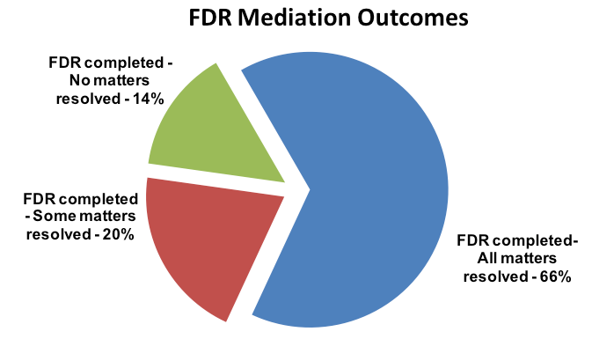
NZ FDR Figures

Slide 16
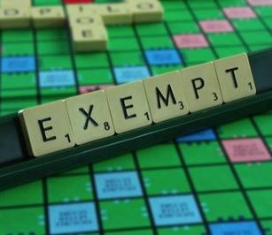
FDR Exemptions
Total of 1,401 exemptions:
  1,106 (79%) where one of the parties did not participate
  209 (15%) where it was inappropriate to continue
  51 (4%) where one of the parties was unable to participate effectively
  17 (1%) where a party was at risk
  18 (1%) where no reason was provided

Slide 17

Australian Experience
Family Disputes Resolution Centre
  Advice, counselling and mediation
Australia Institute of Family Studies (Kaspiew et al 2009)
  70% said it was fine
  22% reduction in applications to court for children matters
  Increases for property
  75% used a lawyer as well
  25% of cases should not have been there because of family violence

Slide 18

Lessons from Australia
Family violence, abuse, and neglect higher than thought – FDR providers not well-equipped to deal with this
NZ Ministry of Justice Review 2011 – most cases other factors at work – mental health, alcohol, abuse etc
Safety issues cases (history of family violence) take longer to sort – need multiple services
50% of FDR includes violence issues
Risk assessment needs to be carried out face-to-face rather than over the phone

Slide 19

Lessons from Australia
Separation of parenting and property issues (by the system)
Parents dissatisfied by the lack of advocacy on their behalf by the FDR providers
Other parents were not ready for FDR
Grandparents left out of the process
Lack of support for those with mental health issues

Slide 20

Lessons from Australia
Slow uptake of FDR at the start
Only 3% of FDR providers used a child focused model
Variations in practice between providers
Complex cases need teamwork between professionals – hard to do
FDR providers recipients of aggression and complaints that used to be aimed at the Court
Agreement at FDR is not always a measure of a successful/desirable outcome

Slide 21

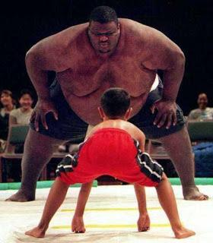
Courts Balance Bargaining Power
“Parties who were reluctant or unable to use court processes found themselves without the protection of law in mediation”
  Batagol & Brown Bargaining in the Shadow of the Law (2011)

Slide 22

Durability?
Trinder & Kellett (2007) (UK MoJ Report)
  Two years later = 60% of agreements broken
  No improvement in the measures of well-being of the children

Slide 23
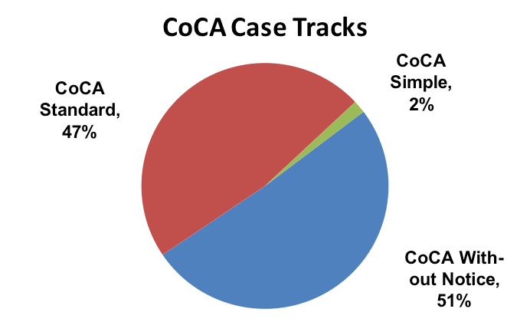
Applications to Court

Slide 24
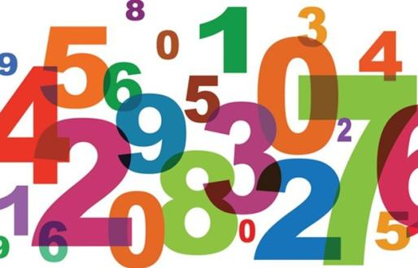
Applications to Court
22% of cases have taken longer than 17 months
Only 286 court cases have been referred to FDR since 31 March 2014

Slide 25

Family Court Application Workload Statistics:
Auckland
New Business
  2011: 5,181
  2013: 5,321
  2015: 3,778
Disposals
  2011: 4,934
  2013: 5,144
  2015: 4,313
Total Active
  2011: 2,545
  2013: 2,540
  2015: 2,352

Slide 26
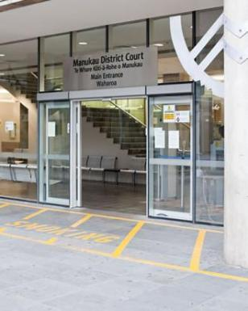
Family Court Application Workload Statistics:
Manukau
New Business
  2011: 5,373
  2013: 4,983
  2015: 4,701
Disposals
  2011: 4,887
  2013: 4,759
  2015: 4,351
Total Active
  2011: 3,256
  2013: 2,565
  2015: 2,650

Slide 27
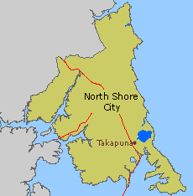
Family Court Application Workload Statistics:
North Shore
New Business
  2011: 3,220
  2013: 2,927
  2015: 2,146
Disposals
  2011: 3,208
  2013: 2,735
  2015: 2,125
Total Active
  2011: 1,415
  2013: 1,385
  2015: 1,173

Slide 28

Family Court Application Workload Statistics:
Hamilton
New Business
  2011: 3,582
  2013: 3,504
  2015: 2,811
Disposals
  2011: 3,584
  2013: 3,376
  2015: 2,997
Total Active
  2011: 1,639
  2013: 1,369
  2015: 1,262

Slide 29

Family Court Application Workload Statistics:
Napier
New Business
  2011: 1,414
  2013: 1,122
  2015: 911
Disposals
  2011: 1,401
  2013: 1,221
  2015: 998
Total Active
  2011: 507
  2013: 489
  2015: 386

Slide 30
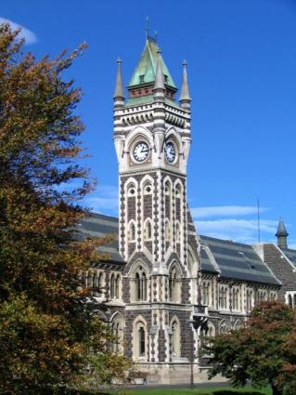
Family Court Application Workload Statistics:
Dunedin
New Business
  2011: 2,108
  2013: 2,069
  2015: 1,491
Disposals
  2011: 2,261
  2013: 2,019
  2015: 1,573
Total Active
  2011: 390
  2013: 469
  2015: 427

Slide 31
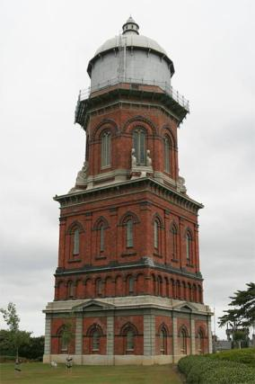
Family Court Application Workload Statistics:
Invercargill
New Business
  2011: 1,397
  2013: 1,345
  2015: 1,076
Disposals
  2011: 1,518
  2013: 1,300
  2015: 958
Total Active
  2011: 437
  2013: 359
  2015: 467

Slide 32

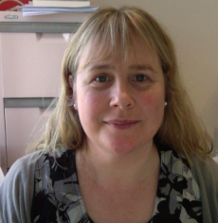
Evaluative Research
Testing how its delivered, managed, and administered
Looking at outcomes, impact, and consequences (both intended and unintended)
Qualitative and quantitative
  What are people guided by?
  What other issues do the families have (mental health problems, drug addictions, alcohol abuse etc?)
  The consequences of the outcome?

Slide 33
NZ Consultations
Ministry of Justice
Principal Family Court Judge
Families Commission
Office of the Children’s Commissioner
Family Law Section, NZ Law Society
Relationships Aotearoa
FairWay Resolution Ltd
LEADR
AMINZ
Family Works Northern
Family Works Central
IRD
Child and family law experts/academics
Specialist report writers/psychologists

Slide 34
International Consultations
Australia
  Australian Institute of Family Studies
  Relationships Australia
  Melbourne CBD Family Relationship Centre
  Attorney-General’s Department
  Family & Relationship Services Australia
  Family law academics - Australia National University and University of Melbourne
England/Wales
  ‘Mapping paths to family justice’ project (Universities of Exeter and Kent)
Canada

Slide 35

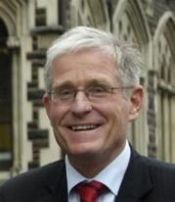

Research: Phase II
Retrospective data collection
  Nationwide online survey with separated parents
  Interviews with a subset of survey participants
  Nationwide online survey of family justice professionals
Prospective data collection
  Tracking a cohort of separated parents as they go through the family justice system

Slide 36
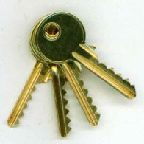

Where To From Here?
THE KEYS
Emotional understanding
  Denial
  Anger
  Grief
  Guilt

Slide 37


THE KEYS
Screening for Power Imbalances
  Violence
  Psychological control
  Economic vulnerability
  Emotional vulnerability

Slide 38


THE KEYS
Learning to communicate better
Pryor - Evaluation of Parenting Through Separation Course
  190 parents (128 in Court, 62 did themselves)
  Conflict major issue
  Course does not improve communication
  A reducing conflict component in course would help

Slide 39




THE KEYS
Legal understanding and support on:
  Children’s issues
  Financial issues
  Property issues

Slide 40
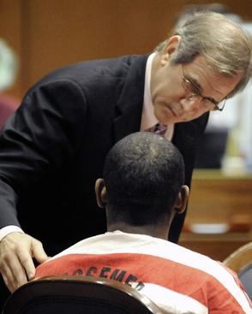
THE KEYS
Howieson 2011
  “A lawyer emphasising protection of his or her clients’ legal rights was an essential part of the conciliatory client-centered approach”
Fairness of procedure = enhances satisfaction and co-operative behaviour

Slide 41


THE KEYS
Understanding the Children’s Perspective
Jen McIntosh
  Child focused priorities
  Child inclusive – concerns fed in
  What is it like to be this child in this family?

Slide 42

THE KEYS
Understanding the Children’s Perspective
  Conflict reduced
  Children’s distress lowered
  Durable and workable

